Slide 1


Digital Logic Circuits

Slide 2






Computer Architecture
is concerned with the structure and behavior of the computer from the user’s point of view.
It is the external view of the computer that anyone who is likely to program a computer should understand.
Computer Organization
is concerned with the way that hardware components operate and the way they are connected to form the computer.
It is the internal view of the computer and the roles various internal components play during program execution.
Computer Design
is concerned with the hardware design of the computer.
It is concerned with decisions like which hardware should be used and how they should be connected.

Slide 3
In this lecture, we will study
Logic gates
Boolean algebra
K-maps and K-map simplification
Combinational circuits (half adder, full adder)

Slide 4

Logic Gates

Slide 5
Logic Gates
In order to manipulate binary information, logic circuits called gates are required.
Gates are blocks of hardware that produce an output of either 0 or 1, depending on the given inputs.

Slide 6
AND
OR
Inverter (aka NOT)
Buffer
Types of Logic Gates
NAND
NOR
Exclusive OR (XOR)
Exclusive NOR (XNOR)

Slide 7
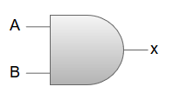

Logic Gates
Name
Symbol
Algebraic Function
Truth Table
A B x
x=A*B or x=AB
AND
0 0 0
0 1 0
1 0 0
1 1 1
A B x
OR
x=A+B
0 0 0
0 1 1
1 0 1
1 1 1

Slide 8


Logic Gates
Name
Symbol
Algebraic Function
Truth Table
A
x
Inverter (aka NOT)
x
x=A’
0
1
1
0
A
x
Buffer
x
x=A
0 0
1 1

Slide 9
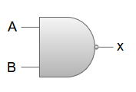

Logic Gates
Name
Symbol
Algebraic Function
Truth Table
A B x
NAND (Not AND)
0 0 1
0 1 1
1 0 1
1 1 0
x=(AB)’
A B x
NOR (Not OR)
x=(A+B)’
0 0 1
0 1 0
1 0 0
1
1
0

Slide 10
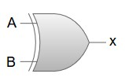



Logic Gates
Name
Symbol
Algebraic Function
Truth Table
A B x
Exclusive OR (XOR)
x=A+B
or
x= A’B+AB’
0 0 0
0 1 1
1 0 1
1 1 0
A B x
Exclusive NOR (XNOR)
x=(A+B)’
or x=A’B’+AB
0 0 1
0 1 0
1 0 0
1
1
0

Slide 11

Exercise
Draw a logic diagram for the following Boolean expression:
F=AB+A’C

Slide 12

Exercise
F=AB+A’C
A
AB
B
A
AC
C

Slide 13
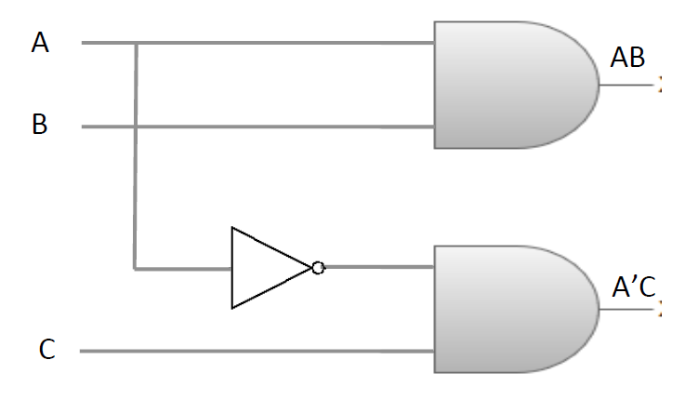
Exercise
F=AB+A’C

Slide 14
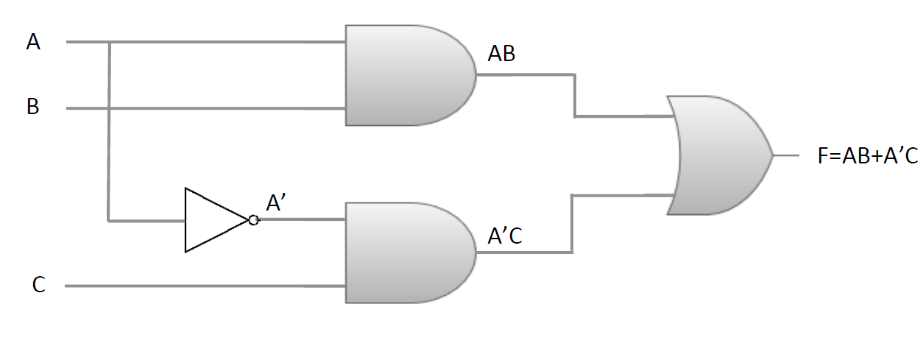
Exercise

Slide 15

Boolean Algebra

Slide 16

Boolean algebra is the algebra that deals with binary variables and logic operations.
Binary Variables: A, B, x, y, etc.
Basic Logic Operation: AND, OR, Complement

Slide 17
A boolean function is expressed using binary variables, logic operation symbols, paratheses, and an equal sign (=).
For instance,
F = x+y’z
is a boolean function, where the function F is equal to 1 if x is 1 or if both y’ and z are equal to 1, and 0 otherwise.

Slide 18
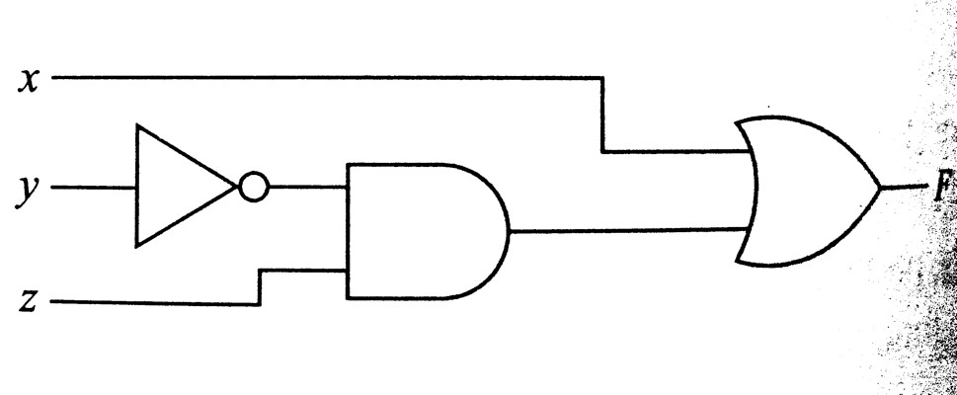
Other Representations of a Boolean Function
Algebraic Logic Diagram Truth Table Expression
x | y | z | F
0 | 0 | 0 | 0
0 | 0 | 1 | 1
0 | 1 | 0 | 0
0 | 1 | 1 | 0
1 | 0 | 0 | 1
1 | 0 | 1 | 1
1 | 1 | 0 | 1
1 | 1 | 1 | 1
F = x + y’ z

Slide 19

Identities and DeMorgan’s Theorem

Slide 20
Identities: List of axioms and theorems
Identity | A + 0 = A | A. 1 = A
Complement | A + A’ = 1 | A. A’ = 0
Commutative | A + B = B + A | A. B = B. A
Assosiative | A + (B + C) = (A + B) + C | A. (B. C) = (A. B). C
Distributive | A. (B + C) = A. B + A. C | A + (B. C) = (A + B). (A + C)
Null Element | A + 1 = 1 | A. 0 = 0
Involution | (A’)’ = A
Indempotency | A + A = A | A. A = A
Absorption | A + (A. B) = A | A. (A + B) = A
Distributive | A + A’. B = A + B | A’ + A.B = A’ + B
De Morgan’s | (A + B)’ = A’. B’ | (A. B)’ = A’+ B’

Slide 21
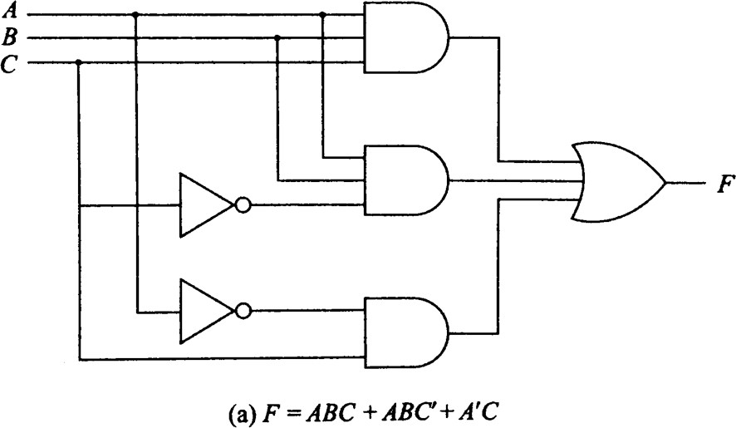
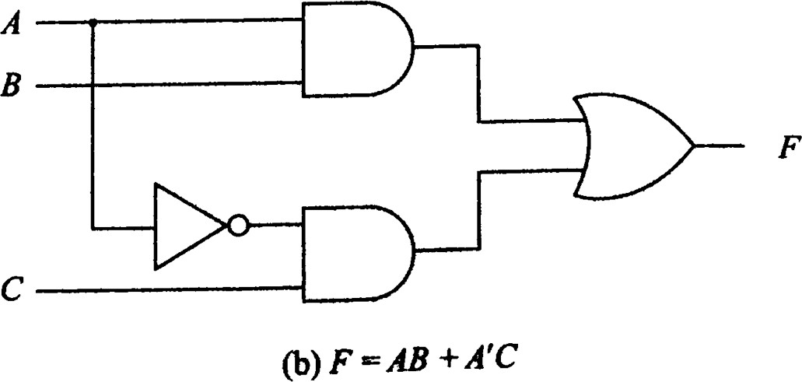

Slide 22
F= ABC+ABC’+A’C F= AB(C+C’)+A’C F= AB(1)+A’C
F= AB+A’C

Slide 23

DeMorgan’s Theorem is crucial for dealing with NAND and NOR gates.
NOR gate: The function (x+y)’ is equivalent to (x’y’).
NAND gate: The function (xy)’ is equivalent to (x’+y’).
For this reason, NOR and NAND gates haves two distinct graphical symbols.

Slide 24
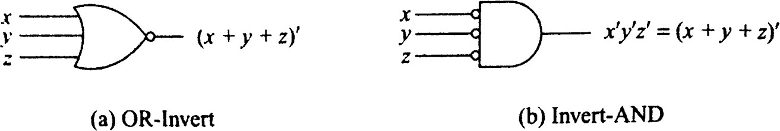
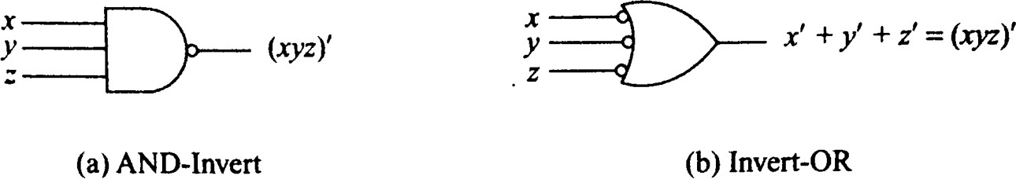
Two graphical symbols for NOR gate
Two graphical symbols for NAND gate
Both NOR and NAND gates are called UNIVERSAL GATES

Slide 25
K-Maps

Slide 26

Why K-Maps?
Increase in complexity of Boolean algebraic expression
Increase in complexity of logic diagram
Complexity can be reduced by simplifying the Boolean algebraic expression
with the help of Karnaugh Map or K-Map.

Slide 27
K (Karnaugh)-maps
Maurice Karnaugh introduced it in 1953
K Map is a graphical representation used for simplifying the Boolean expressions.
For a Boolean expression consisting of n-variables, the number of cells required in K Map = 2^{n} cells.
K Map is based on the Grey code(Unit distance code).
K Map is based on three types of Input values(0, 1, don't care)

Slide 28
Minterms
A minterm is a Boolean expression resulting in 1 for the output of a single cell, and 0s for all other cells in a Karnaugh map or a truth table.
A B C F
In this sample truth table, we have five minterms, namely:
A’B’C, AB’C’, AB’C, ABC’, and ABC
(because for F= A’B’C, F=AB’C’, F=AB’C, F=ABC’, and F=ABC , the
output is 1, and for all other Boolean expressions, the output is 0).
0 | 0 | 0 | 0
0 | 0 | 1 | 1
0 | 1 | 0 | 0
0 | 1 | 1 | 0
1 | 0 | 0 | 1
1 | 0 | 1 | 1
1 | 1 | 0 | 1
1 | 1 | 1 | 1

Slide 29
Representing Truth Tables as Minterms
A | B | C | F
0 | 0 | 0 | 0
0 | 0 | 1 | 1
0 | 1 | 0 | 0
0 | 1 | 1 | 0
1 | 0 | 0 | 1
1 | 0 | 1 | 1
1 | 1 | 0 | 1
1 | 1 | 1 | 1
=
F(A, B, C) = Σ (1, 4, 5, 6, 7)
Here, the cells 1, 4, 5, 6, and 7 represent the minterms.

Slide 30

K-Maps
A | B | C | F
0 | 0 | 0 | 0
0 | 0 | 1 | 1
0 | 1 | 0 | 0
0 | 1 | 1 | 0
1 | 0 | 0 | 1
1 | 0 | 1 | 1
1 | 1 | 0 | 1
1 | 1 | 1 | 1
=
A
F(A, B, C) = Σ (1, 4, 5, 6, 7)
B, C
00
01
11
10
0 | 0 | 1 | 1 | 3 | 0 | 2 | 0
4 |  | 5 |  | 7 |  | 6
 | 1 |  | 1 |  | 1 |  | 1
0
1

Slide 31



K-Maps for 2, 3, and 4 variable functions
B
A
B, C
0
1
0
1
A
00
01
11
10
0 | 1
2 | 3
0
1
0 | 1 | 3 | 2
4 | 5 | 7 | 6
C, D
A, B
00
01
11
10
00
01
11
10
0 | 1 | 3 | 2
4 | 5 | 7 | 6
12 | 13 | 15 | 14
8 | 9 | 11 | 10

Slide 32



K-Map Simplification
F(A, B, C) = Σ (3, 4, 6, 7)
B, C
A
00
01
11
10
0 | 0 | 1 | 0 | 3 | 1 | 2 | 0
4 |  | 5 |  | 7 |  | 6
 | 1 |  | 0 |  | 1 |  | 1
0
1

Slide 33



K-Map Simplification
F(A, B, C) = Σ (3, 4, 6, 7)
B, C
A
00
01
11
10
0 | 0 | 1 | 0
1 | 0 | 1 | 1
0
1

Slide 34








K-Map Simplification
B, C
A
0
00 | 01 | 11 | 10
0 | 0 | 1 | 0
1 | 0 | 1 | 1
1
F= BC+ AC’

Slide 35



K-Map Simplification
B, C
A
0
00 | 01 | 11 | 10
0 | 0 | 1 | 0
1 | 0 | 1 | 1
Consider Essential prime implicants
1
F= BC+ AC’ + AB
Additional term

Slide 36



K-Map Simplification
F(A, B, C, D) = Σ (0, 2, 5, 7, 8, 10, 13, 15)
C, D
A, B
00
01
11
10
00
01
11
10
1 | 0 | 0 | 1
0 | 1 | 1 | 0
0 | 1 | 1 | 0
1 | 0 | 0 | 1

Slide 37



K-Map Simplification
F(A, B, C, D) = Σ (0, 2, 5, 7, 8, 10, 13, 15)
C, D
A, B
00
01
11
10
00
01
11
10
1 | 0 | 0 | 1
0 | 1 | 1 | 0
0 | 1 | 1 | 0
1 | 0 | 0 | 1

Slide 38




K-Map Simplification
C, D
00 01 11 10
A, B
1 0 0 1
0 1 1 0
0 1 1 0
10 1 0 0 1
00
01
11
F= BD+ B’D’
(other solutions are also possible)
38

Slide 39
Exercise
F(A, B, C, D) = Σ (1, 3, 4, 5, 6, 9, 11, 12, 13, 14)

Slide 40
Exercise
F(A, B, C, D) = Σ (1, 3, 4, 5, 6, 9, 11, 12, 13, 14)
C, D
A, B
00
01
11
10
00
01
11
10
0 | 1 | 1 | 0
1 | 1 | 0 | 1
1 | 1 | 0 | 1
0 | 1 | 1 | 0

Slide 41
Exercise
F(A, B, C, D) = Σ (1, 3, 4, 5, 6, 9, 11, 12, 13, 14)
C, D
A, B
00
01
11
10
00
0
1
1
0
1
1
0
1
01
1
1
0
1
11
0
1
1
0
10
41

Slide 42

Exercise
C, D
A, B
00
01
11
10
00 0
1
1
0
1
1
0
1
01
1
1
0
1
11
0
1
1
0
10
F= BC'+B'D+BCD’

Slide 43



The maps we have seen so far can also be referred to as the ‘SUM OF PRODUCTS’ form of K-Maps
C, D
00 01 11 10
A, B
00
0 1 1 0
1 1 0 1
1 1 0 1
0 1 1 0
01
F= BC+B’D+BCD’
(other solutions are also possible)
11
10
F(A, B, C, D) = Σ (1, 3, 4, 5, 6, 9, 11, 12, 13, 14)

Slide 44
Another Representation of K-Maps:
Product of Sums (POS)
A | B | C | F
0 | 0 | 0 | 0
0 | 0 | 1 | 1
0 | 1 | 0 | 0
0 | 1 | 1 | 0
1 | 0 | 0 | 1
1 | 0 | 1 | 1
1 | 1 | 0 | 1
1 | 1 | 1 | 1
=
F(A, B, C) = Π (0, 2, 3)

Slide 45
Maxterms
A maxterm is a Boolean expression resulting in 0 for the output of a single cell, and 1s for all other cells in a Karnaugh map or a truth table.
A B C F
In this sample truth table, we have three maxterms, namely:
A+B+C, A+B'+C, and A+B'+C'
(because for A+B+C, A+B'+C, and A+B'+C', the output is 0, and for all other Boolean expressions, the output is 1).
0 | 0 | 0 | 0
0 | 0 | 1 | 1
0 | 1 | 0 | 0
0 | 1 | 1 | 0
1 | 0 | 0 | 1
1 | 0 | 1 | 1
1 | 1 | 0 | 1
1 | 1 | 1 | 1

Slide 46
Representing Truth Tables as Maxterms
A | B | C | F
0 | 0 | 0 | 0
0 | 0 | 1 | 1
0 | 1 | 0 | 0
0 | 1 | 1 | 0
1 | 0 | 0 | 1
1 | 0 | 1 | 1
1 | 1 | 0 | 1
1 | 1 | 1 | 1
=
F(A, B, C) = Π (0, 2, 3)
Here, the cells 0, 2, and 3 represent the maxterms.

Slide 47





C, D
A, B
00
01
11
10
00
01
0 | 1 | 1 | 0
1 | 1 | 0 | 1
1 | 1 | 0 | 1
0 | 1 | 1 | 0
SUM OF PRODUCTS
11
PRODUCT of SUMS
10
F(A, B, C, D) = Σ (1, 3, 4, 5, 6, 9
11, 12, 13, 14)
F(A, B, C, D) = Π (0, 2, 7, 8, 10, 15)

Slide 48
POS Simplification
F(A, B, C, D) = Π (3, 6, 7, 11, 12, 13, 14, 15)
C, D
A, B
00
01
11
10
00
01
11
10
1 | 1 | 0 | 1
1 | 1 | 0 | 0
0 | 0 | 0 | 0
1 | 1 | 0 | 1

Slide 49
POS Simplification
F(A, B, C, D) = Π (3, 6, 7, 11, 12, 13, 14, 15)
C, D
A, B
00
01
11
10
00
1
1
0
1
1
1
0
0
01
0
0
0
0
11
1
1
0
1
10
49

Slide 50


POS Simplification
C, D
00 01 11 10
A, B
00
1 1 0 1
1 1 0 0
0 0 0 0
1 1 0 1
01
11
10
F= (C’+D’) (A’+B’) (B’+C’)
(other solutions are also possible)
50

Slide 51


5-Variable K-Maps
A = 0
A = 1
D, E
D, E
00
01
11
10
B, C
00
01
11
10
B, C
0 | 1 | 3 | 2
4 | 5 | 7 | 6
12 | 13 | 15 | 14
8 | 9 | 11 | 10
00
16 | 17 | 19 | 18
20 | 21 | 23 | 22
28 | 29 | 31 | 30
24 | 25 | 27 | 26
00
01
01
11
11
10
10
Cell 0 can be considered to be ‘adjacent’ to cell 16, cell 1 can be considered to be adjacent to cell 17, and so on.

Slide 52
Simplification of 5-Variable K-Maps
F(A, B, C, D, E) = Σ (1, 2, 3, 5, 7, 11, 13, 17, 19, 23, 29, 31)
Or
^{F(A, B, C, D, E)= m}1^{, m}2^{, m}3, ^{m}5, ^{m}7, ^{m}11, ^{m}13, ^{m}17, ^{m}19, ^{m}23, ^{m}29, ^{m}31

Slide 53


Simplification of 5-Variable K-Maps: Step 1
F(A, B, C, D, E) = Σ (1, 2, 3, 5, 7, 11, 13, 17, 19, 23, 29, 31)
A = 0
A = 1
D, E
D, E
00
01
11
10
B, C
00
01
11
10
B, C
0 | 1 | 1 | 1
0 | 1 | 1 | 0
0 | 1 | 0 | 0
0 | 0 | 1 | 0
00
0 | 1 | 1 | 0
0 | 0 | 1 | 0
0 | 1 | 1 | 0
0 | 0 | 0 | 0
00
01
01
11
11
10
10

Slide 54


Simplification of 5-Variable K-Maps: Step 2
F(A, B, C, D, E) = Σ (1, 2, 3, 5, 7, 11, 13, 17, 19, 23, 29, 31)
A = 0
A = 1
D, E
D, E
00
01
11
10
B, C
00
01
11
10
B, C
0 | 1 | 1 | 1
0 | 1 | 1 | 0
0 | 1 | 0 | 0
0 | 0 | 1 | 0
00
0 | 1 | 1 | 0
0 | 0 | 1 | 0
0 | 1 | 1 | 0
0 | 0 | 0 | 0
00
01
01
11
11
10
10
A’B’E
54

Slide 55
Simplification of 5-Variable K-Maps: Step 3
F(A, B, C, D, E) = Σ (1, 2, 3, 5, 7, 11, 13, 17, 19, 23, 29, 31)
A = 0
A = 1
D, E
D, E
00 | 01 | 11 | 10
0 | 1 | 1 | 1
0 | 1 | 1 | 0
0 | 1 | 0 | 0
0 | 0 | 1 | 0
B, C
00
01
11
10
B, C
00
0 | 1 | 1 | 0
0 | 0 | 1 | 0
0 | 1 | 1 | 0
0 | 0 | 0 | 0
00
01
01
11
11
10
10
A’B’E+ A’B’C’D
55

Slide 56
Simplification of 5-Variable K-Maps: Step 4
F(A, B, C, D, E) = Σ (1, 2, 3, 5, 7, 11, 13, 17, 19, 23, 29, 31)
A = 0
A = 1
D, E
D, E
00 | 01 | 11 | 10
0 | 1 | 1 | 1
0 | 1 | 1 | 0
0 | 1 | 0 | 0
0 | 0 | 1 | 0
B, C
00
01
11
10
B, C
00
0 | 1 | 1 | 0
0 | 0 | 1 | 0
0 | 1 | 1 | 0
0 | 0 | 0 | 0
00
01
01
11
11
10
10
A’B’E+ A’B’C’D+A’CD’E
56

Slide 57
Simplification of 5-Variable K-Maps: Step 5
F(A, B, C, D, E) = Σ (1, 2, 3, 5, 7, 11, 13, 17, 19, 23, 29, 31)
A = 0
A = 1
D, E
D, E
00
01
11
10
B, C
00
01
11
10
B, C
0
1
1
1
00
0 | 1 | 1 | 0
0 | 0 | 1 | 0
0 | 1 | 1 | 0
0 | 0 | 0 | 0
00
0
1
1
0
01
01
0
1
0
0
11
11
0
0
1
0
10
10
A’B’E+ A’B’C’D+A’CD’E+A’C’DE
57

Slide 58
Simplification of 5-Variable K-Maps: Step 6
F(A, B, C, D, E) = Σ (1, 2, 3, 5, 7, 11, 13, 17, 19, 23, 29, 31)
A = 0
A = 1
D, E
D, E
00
01
11
10
B, C
00
01
11
10
B, C
0
1
1
1
00
0 | 1 | 1 | 0
0 | 0 | 1 | 0
0 | 1 | 1 | 0
0 | 0 | 0 | 0
00
0
1
1
0
01
01
0
1
0
0
11
11
0
0
1
0
10
10
A’B’E+ A’B’C’D+A’CD’E+A’C’DE
AB’DE
58

Slide 59
Simplification of 5-Variable K-Maps: Step 7
F(A, B, C, D, E) = Σ (1, 2, 3, 5, 7, 11, 13, 17, 19, 23, 29, 31)
A = 0
A = 1
D, E
D, E
00
01
11
10
B, C
00
01
11
10
B, C
0
1
1
1
00
0
1
1
0
00
0
1
1
0
01
0
0
1
0
01
0
1
0
0
11
0
1
1
0
11
0
0
1
0
0
0
0
0
10
10
A’B’E+ A’B’C’D+A’CD’E+A’C’DE
AB’DE+ABCE
59

Slide 60


Simplification of 5-Variable K-Maps: Step 8
F(A, B, C, D, E) = Σ (1, 2, 3, 5, 7, 11, 13, 17, 19, 23, 29, 31)
A = 0
A = 1
D, E
D, E
00
01
11
10
B, C
00
01
11
10
B, C
0
1
1
1
00
0
1
1
0
00
0
1
1
0
01
0
0
1
0
01
0
1
0
0
11
0
1
1
0
11
0
0
1
0
0
0
0
0
10
10
A’B’E+ A’B’C’D+A’CD’E+A’C’DE
B’C’E
AB’DE+ABCE
60

Slide 61


Simplification of 5-Variable K-Maps: Solution
F(A, B, C, D, E) = Σ (1, 2, 3, 5, 7, 11, 13, 17, 19, 23, 29, 31)
F = A’B’E+ A’B’C’D+A’CD’E+A’C’DE+B’C’E+AB’DE+ABCE

Slide 62
Alternative Representations of 5-Variable K-Maps
Reflection Maps Overlay Maps

Slide 63


5-Variable Reflection K-Map
C, D, E
A, B
000 001 011 010 110 111 101 100
00
01
11
10
0 | 1 | 3 | 2 | 6 | 7 | 5 | 4
8 | 9 | 11 | 10 | 14 | 15 | 13 | 12
24 | 25 | 27 | 26 | 30 | 31 | 29 | 28
16 | 17 | 19 | 18 | 22 | 23 | 21 | 20
Think of this line as a mirror

Slide 64

Simplification of Reflection Map: Step 1
F(A, B, C, D, E) = Σ (1, 2, 3, 5, 7, 11, 13, 17, 19, 23, 29, 31)
C, D, E
A, B
000 001 011 010 110 111 101 100
00
01
11
10
0 | 1 | 1 | 1 | 0 | 1 | 1 | 0
0 | 0 | 1 | 0 | 0 | 0 | 1 | 0
0 | 0 | 0 | 0 | 0 | 1 | 1 | 0
0 | 1 | 1 | 0 | 0 | 1 | 0 | 0

Slide 65

Simplification of Reflection Map: Step 2
F(A, B, C, D, E) = Σ (1, 2, 3, 5, 7, 11, 13, 17, 19, 23, 29, 31)
C, D, E
A, B
 | 000 | 001 | 011 | 010 | 110 | 111 | 101 | 100
00 | 0 | 1 | 1 | 1 | 0 | 1 | 1 | 0
01 | 0 | 0 | 1 | 0 | 0 | 0 | 1 | 0
11 | 0 | 0 | 0 | 0 | 0 | 1 | 1 | 0
0
1
1
0
0
1
0
0
10
B’C’E

Slide 66
Simplification of Reflection Map: Step 3
F(A, B, C, D, E) = Σ (1, 2, 3, 5, 7, 11, 13, 17, 19, 23, 29, 31)
C, D, E
A, B
 | 000 | 001 | 011 | 010 | 110 | 111 | 101 | 100
00 | 0 | 1 | 1 | 1 | 0 | 1 | 1 | 0
01 | 0 | 0 | 1 | 0 | 0 | 0 | 1 | 0
11 | 0 | 0 | 0 | 0 | 0 | 1 | 1 | 0
0
1
1 0 0 1
B’C’E+A’B’C’D
0
0
10

Slide 67
Simplification of Reflection Map: Step 4
F(A, B, C, D, E) = Σ (1, 2, 3, 5, 7, 11, 13, 17, 19, 23, 29, 31)
C, D, E
A, B
000 001 011 010 110 111 101 100
0 1 1 1 0 1 1 0
0 0 1 0 0 0 1 0
0 0 0 0 0 1 1 0
0 1 1 0 0 1 0 0
B’C’E+A’B’C’D+A’C’DE
00
01
11
10

Slide 68
Simplification of Reflection Map: Step 5
F(A, B, C, D, E) = Σ (1, 2, 3, 5, 7, 11, 13, 17, 19, 23, 29, 31)
C, D, E
A, B
000 001 011 010 110 111 101 100
0 1 1 1 0 1 1 0
0 0 1 0 0 0 1 0
0 0 0 0 0 1 1 0
0 1 1 0 0 1 0 0
00
01
11
10
B’C’E+A’B’C’D+A’C’DE+ABCE

Slide 69


Simplification of Reflection Map: Step 6
F(A, B, C, D, E) = Σ (1, 2, 3, 5, 7, 11, 13, 17, 19, 23, 29, 31)
C, D, E
A, B
000 001 011 010 110 111 101 100
0 1 1 1 0 1 1 0
0 0 1 0 0 0 1 0
0 0 0 0 0 1 1 0
0 1 1 0 0 1 0 0
00
01
11
10
B’C’E+A’B’C’D+A’C’DE+ABCE+A’B’E

Slide 70


Simplification of Reflection Map: Step 7
F(A, B, C, D, E) = Σ (1, 2, 3, 5, 7, 11, 13, 17, 19, 23, 29, 31)
C, D, E
A, B
000 001 011 010 110 111 101 100
0 1 1 1 0 1 1 0
0 0 1 0 0 0 1 0
0 0 0 0 0 1 1 0
0 1 1 0 0 1 0 0
B’C’E+A’B’C’D+A’C’DE+ABCE+A’B’E+A’CD’E
00
01
11
10
70

Slide 71


Simplification of Reflection Map: Step 8
F(A, B, C, D, E) = Σ (1, 2, 3, 5, 7, 11, 13, 17, 19, 23, 29, 31)
C, D, E
A, B
000 001 011 010 110 111 101 100
0 1 1 1 0 1 1 0
0 0 1 0 0 0 1 0
0 0 0 0 0 1 1 0
0 1 1 0 0 1 0 0
00
01
11
10
B’C’E+A’B’C’D+A’C’DE+ABCE+A’B’E+A’CD’E+AB’DE

Slide 72
Overlay Maps?

Slide 73
5-Variable Overlay K-Map
C, D, E
A, B
000 001 011 010 100 101 111 110
00
01
11
10
0 | 1 | 3 | 2 | 4 | 5 | 7 | 6
8 | 9 | 11 | 10 | 12 | 13 | 15 | 14
24 | 25 | 27 | 26 | 28 | 29 | 31 | 30
16 | 17 | 19 | 18 | 20 | 21 | 23 | 22

Slide 74


5-Variable Reflection K-Map
5-Variable Overlay K-Map
C, D, E
000 001 011 010 110 111 101 100
C, D, E
000 001 011 010 100 101 111 110
A, B
A, B
0 | 1 | 3 | 2 | 6 | 7 | 5 | 4
8 | 9 | 11 | 10 | 14 | 15 | 13 | 12
24 | 25 | 27 | 26 | 30 | 31 | 29 | 28
16 | 17 | 19 | 18 | 22 | 23 | 21 | 20
0 | 1 | 3 | 2 | 4 | 5 | 7 | 6
8 | 9 | 11 | 10 | 12 | 13 | 15 | 14
24 | 25 | 27 | 26 | 28 | 29 | 31 | 30
16 | 17 | 19 | 18 | 20 | 21 | 23 | 22
00
00
01
01
11
11
10
10
Reflection maps use the ‘Gray Code’

Slide 75
Simplification of Overlay Map
F(A, B, C, D, E) = Σ (3, 5, 6, 7, 9, 10, 11, 12, 13, 14, 17, 18,
19, 20, 21, 22, 24, 25, 26, 28)
C, D, E
A, B
000 001 011 010 100 101 111 110
00
01
11
10
0 | 0 | 1 | 0 | 0 | 1 | 1 | 1
0 | 1 | 1 | 1 | 1 | 1 | 0 | 1
1 | 1 | 0 | 1 | 1 | 0 | 0 | 0
0 | 1 | 1 | 1 | 1 | 1 | 0 | 1

Slide 76






Simplification of Overlay Map
F(A, B, C, D, E) = Σ (3, 5, 6, 7, 9, 10, 11, 12, 13, 14, 17, 18, 19, 20, 21, 22, 24, 25, 26, 28)
C, D, E
A, B
000 001 011 010 100 101 111 110
00
0
0
1
0
0
1
1
1
01
0
1
1
1
1
1
0
1
11
1
1
0
1
1
0
0
0
0
1
1
1
1
1
0
1
10

Slide 77


5-Variable K-Map with Don’t Care Conditions
F(A, B, C, D, E)= Σ(1, 2, 3, 8, 9, 10, 12, 15, 16, 17, 18, 22, 26, 27)
+d(0, 4, 11, 19, 28, 30, 31)
A = 0
A = 1
D, E
D, E
00
01
11
10
B, C
00
01
11
10
B, C
x | 1 | 1 | 1
x | 0 | 0 | 0
1 | 0 | 1 | 0
1 | 1 | x | 1
00
1 | 1 | x | 1
0 | 0 | 0 | 1
x | 0 | x | x
0 | 0 | 1 | 1
00
01
01
11
11
10
10

Slide 78

Homework
Simplify the following Boolean function:
F(A,B,C,D,E)=Σ(0, 1, 2, 3, 8, 12, 15, 16, 17, 18, 19, 22, 28, 31)

Slide 79

K-Maps with Don’t Care Conditions
Sometimes, we have function where it doesn’t matter whether the output is 0 or 1; it can be either.
These are known as ‘DON’T CARE CONDITIONS’. Such conditions are marked with an ‘x’ in the map.
B, C
A
00 01 11 10
1 | x | x | 1
0 | x | 1 | 0
0
F(A, B, C)= Σ(0, 2, 7)+d(1, 3, 5 )
1

Slide 80

Map Simplification in the Presence of Don’t Care Conditions
B, C
A
00
01
11
10
1 | x | x | 1
0 | x | 1 | 0
0
F= A’+A’C
1

Slide 81
Combinational Circuits

Slide 82
Combinational Circuits
A combinational circuit is a connected arrangement of logic gates with a set of inputs and outputs.
Combinational Circuits
Half Adder
Full Adder

Slide 83
Adders
Addition is the most basic digital arithmetic operation.
A combinational circuit that adds two bits is called a HALF-ADDER
and
the one that adds three bits (i.e., two significant bits and a previous carry) is called a FULL-ADDER.

Slide 84
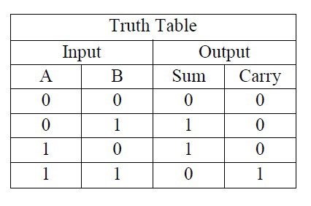
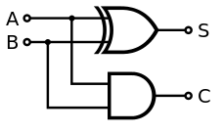

Half-Adder
Truth Table
Logic Diagram
S (sum)= A’B+AB’= A+B
C (carry)= AB

Slide 85
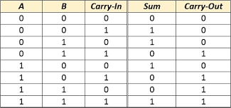
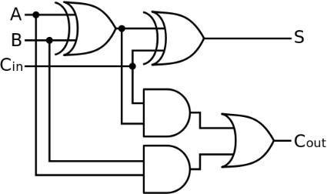



Full-Adder
Truth Table
Logic Diagram
S (sum)= A+B+C_{in} C_{out} (carry)= AB+(A+B)C_{in}

Slide 86


Slide 87
Homework 1
Simplify the following Boolean functions:
F(A,B,C,D)=Σ(1, 3, 7, 8, 9, 12, 13, 14, 15)
F(A,B,C,D)=Π(0, 2, 4, 5, 8, 10, 12, 13)

Slide 88

Homework 2
Given the following Boolean function:
F=x+x’y’
List the truth table
Draw the logic circuit

Slide 89
Boolean Function Truth Table
F = x + x’ y’ | x | y | x’ | y’ | x’y’ | x+x’y’ (=F)

Slide 90
In the next lecture, we will study…
Flip – Flops
Sequential circuits
Decoders
Multiplexers
Registers

